Slide 1
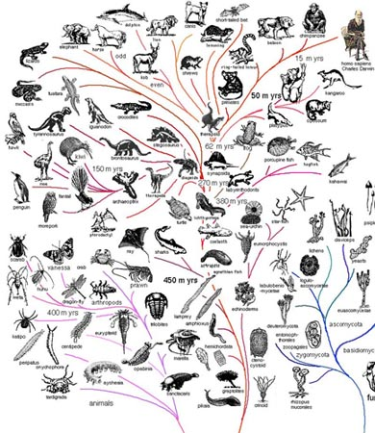
All life of Earth, both living and extinct, is connected by evolution

Slide 2
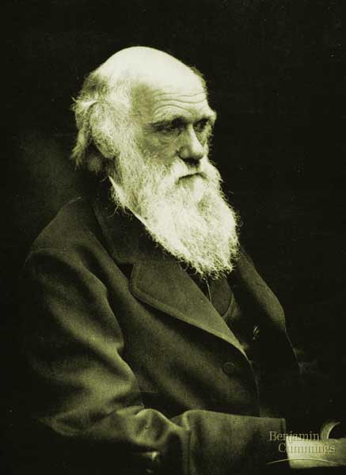
Extra Photo 13.03x2

Slide 3
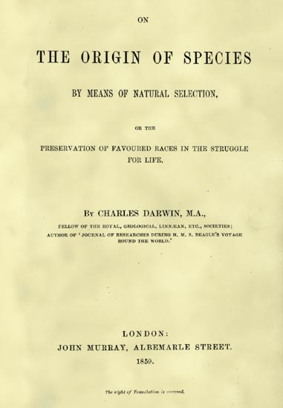
Extra Photo 13.03x7

Slide 4
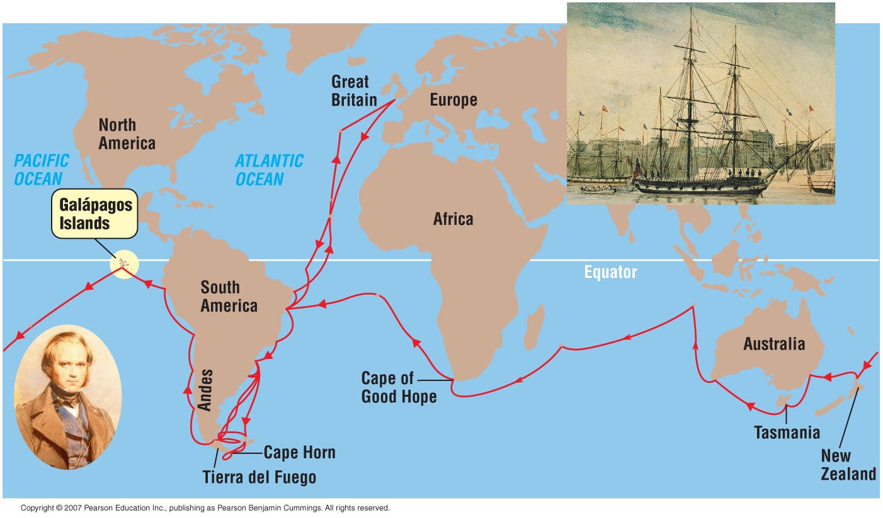
Figure 13.4

Slide 5
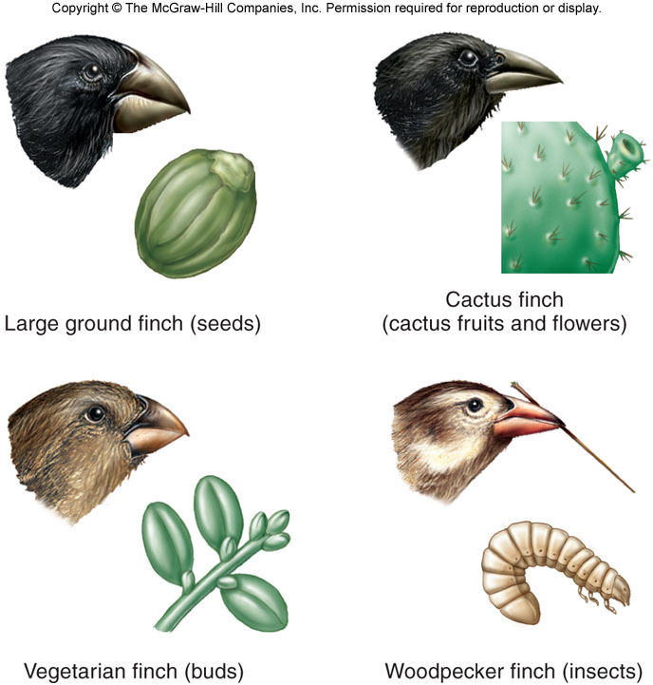
Fig. 2.5

Slide 6
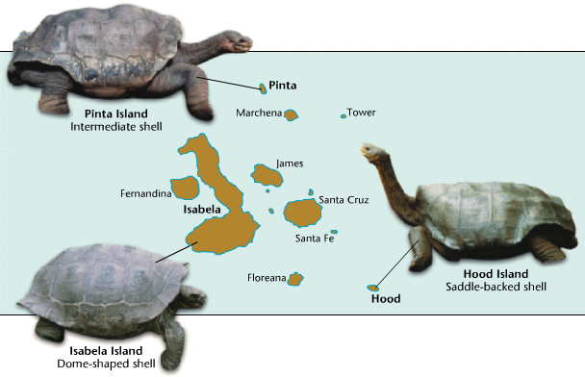
Darwin’s Observations: adaptations in organisms of the Galapagos
ex: tortoises on different islands differed in predictable ways
Environment: Isabela Island is lush with vegetation. Pinta and Hood Islands are
drier populated w a tall cactus. Adaptations?
Notes:
Physical features (including shape of the shell) relate to the habitat of each of the subspecies. These differences were noted by Captain Porter[4] even before Charles Darwin. Larger islands with more wet highlands such as Santa Cruz and the Alcedo Volcano on Isabela have lush vegetation near the ground. Tortoises here tend to have 'dome-back' shells. These animals have restricted upward head movement due to shorter necks, and also have shorter limbs. These are the heaviest and largest of the subspecies.Smaller, drier islands such as Española and Pinta are inhabited by tortoises with 'saddleback' shells comprising a flatter carapace which is elevated above the neck and flared above the hind feet. Along with longer neck and limbs, this allows them to browse taller vegetation. On these drier islands the Galápagos Opuntia cactus (a major source of their fluids) has evolved a taller, tree-like form. This is evidence of an evolutionary arms race between progressively taller tortoises and correspondingly taller cacti. Saddlebacks are smaller in size than domebacks. They tend to have a yellowish color on lower mandible and throat. At one extreme, the Sierra Negra volcano population that inhabits southern Isabela Island has a very flattened "tabletop" shell. However, there is no saddleback/domeback dualism; tortoises can also be of 'intermediate' type with characteristics of both.

Slide 7
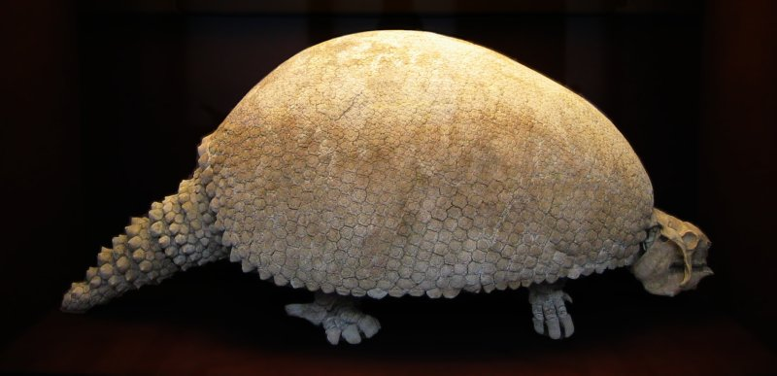
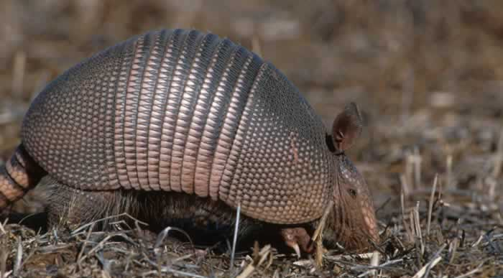
Darwin’s Observations: the relationship of fossils to living organisms
some fossils resemble, but are not identical to, living organisms
fossilized glyptodon modern day armadillo
Observed by Darwin in South America

Slide 8
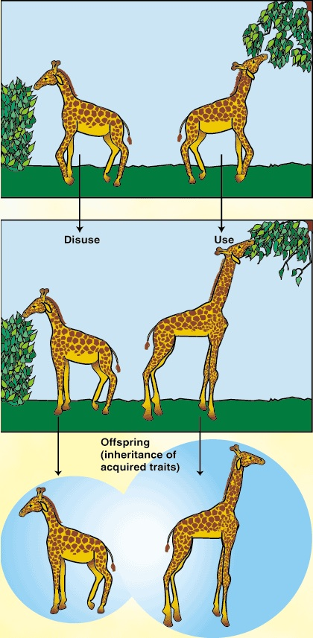
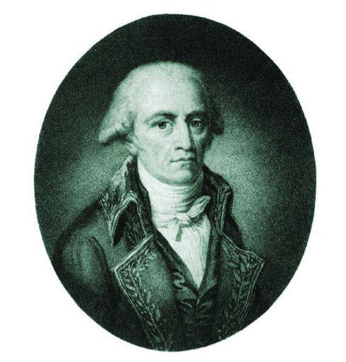
Darwin’s Influences:
Jean-Baptiste Lamarck (1744-1829)
organisms on Earth have changed over time and that they are suited to particular environments
use & disuse

Slide 9
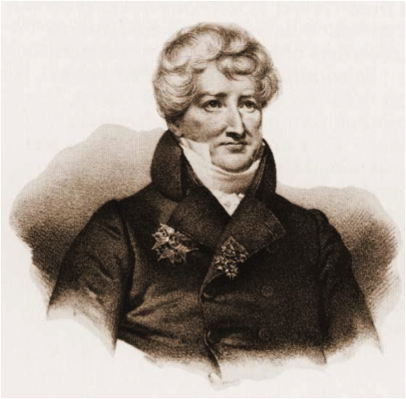
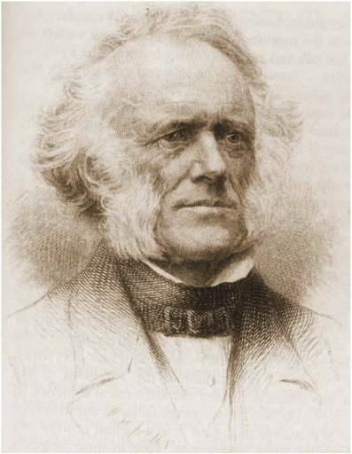
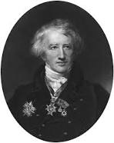
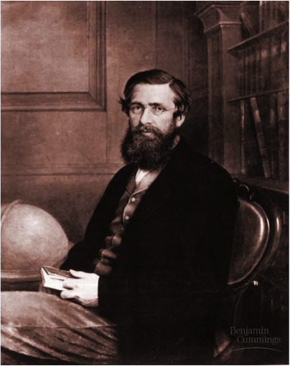
Darwin’s Influences:
Thomas Malthus: exponential
population growth
Charles Lyell: Earth is really old
Georges Cuvier:
Paleontology
Alfred Wallace:
similar idea

Slide 10
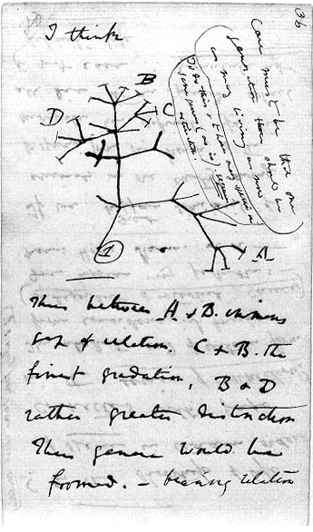

Slide 11
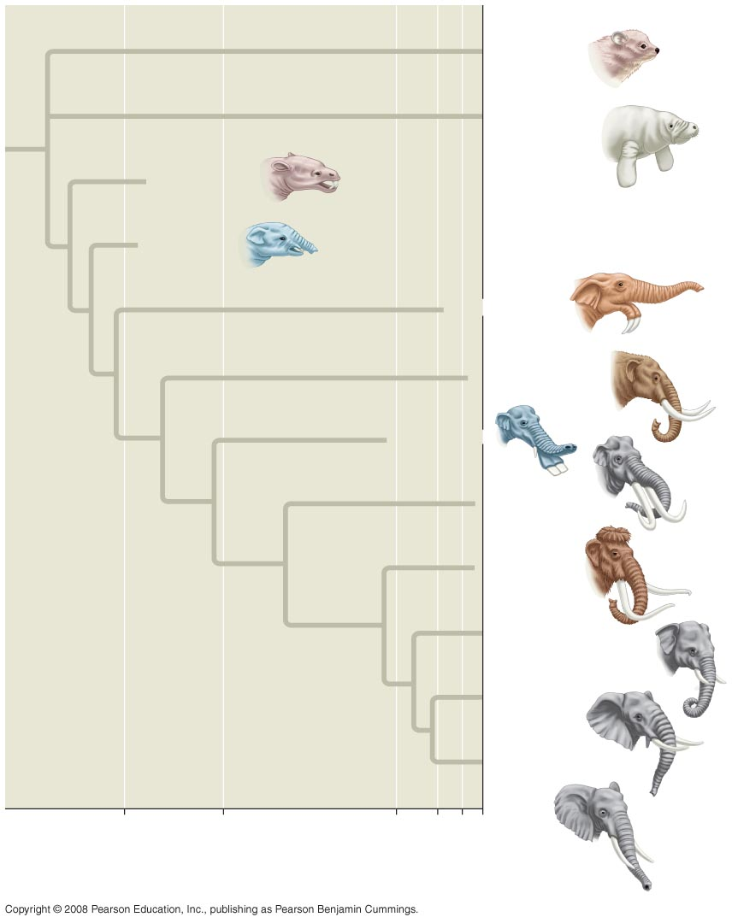
Two key components of On the Origin of Species: 1. descent with modification (evolution)
Hyracoidea
(Hyraxes)
Sirenia
(Manatees
and relatives)
Moeritherium
Barytherium
Deinotherium
Mammut
Platybelodon
Stegodon
Mammuthus
Elephas maximus
(Asia)
Loxodonta
africana
(Africa)
Loxodonta cyclotis
(Africa)
34
24
5.5
2
10⁴
0
Fig. 22-8
Millions of years ago
Years ago

Slide 12
“Can we doubt… that individuals having any advantages, however slight, over others, would have the best chance of surviving and procreating their kind? On the other hand, we may feel sure that any variation in the least degree injurious would be rigidly destroyed. This preservation of favorable variations, I call Natural Selection.”
(Darwin, On the Origin of Species)

Slide 13
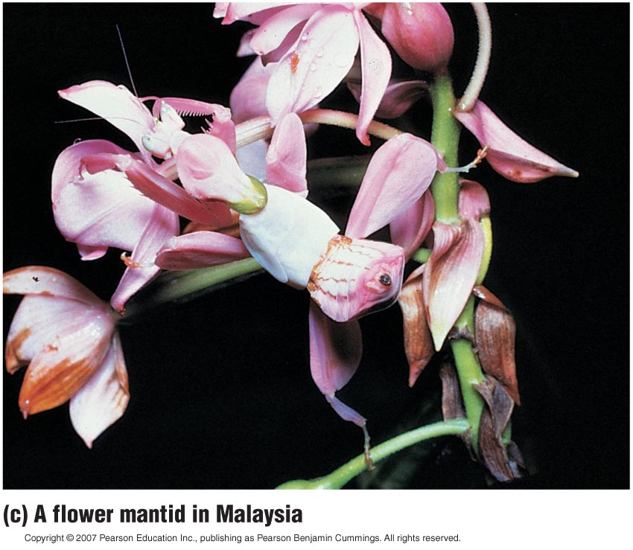
Figure 13.2c

Slide 14
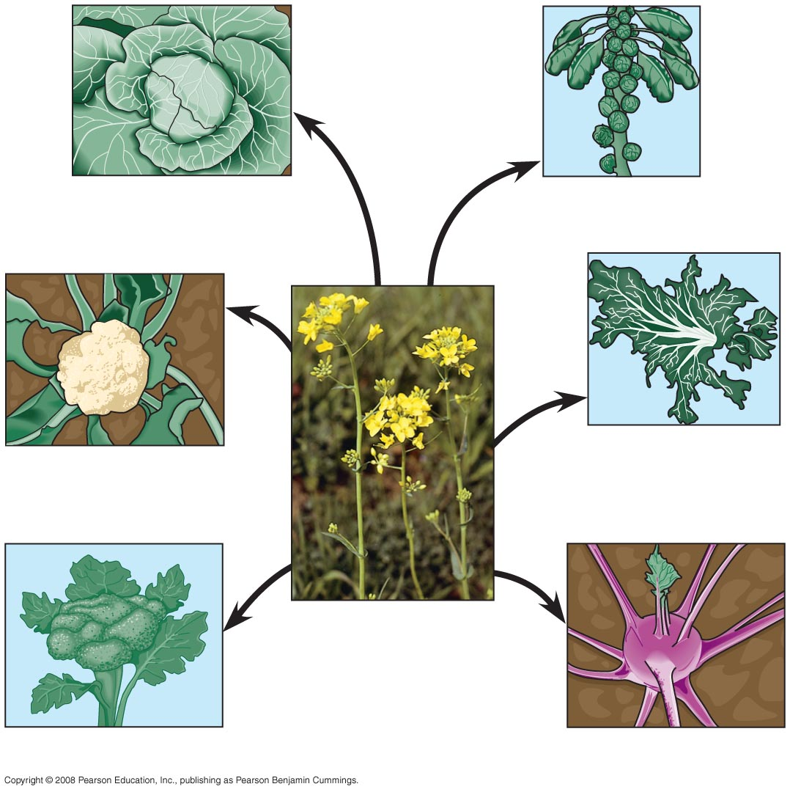
Darwin used examples of selective breeding and artificial selection to help explain his theory of natural selection
Terminal
bud
Lateral
buds
Cabbage
Brussels sprouts
Flower
clusters
Leaves
Kale
Cauliflower
Stem
Wild mustard
Flowers
and stems
Fig. 22-9
Broccoli
Kohlrabi

Slide 15
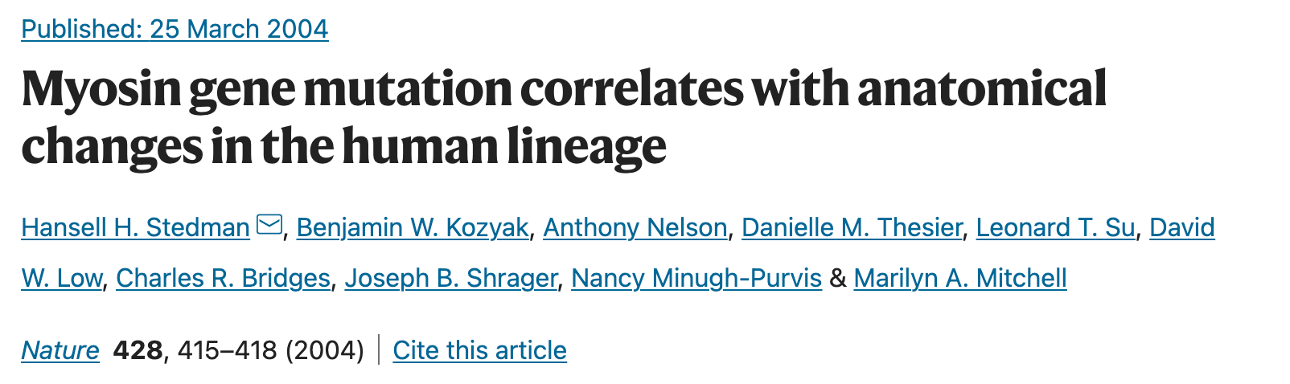
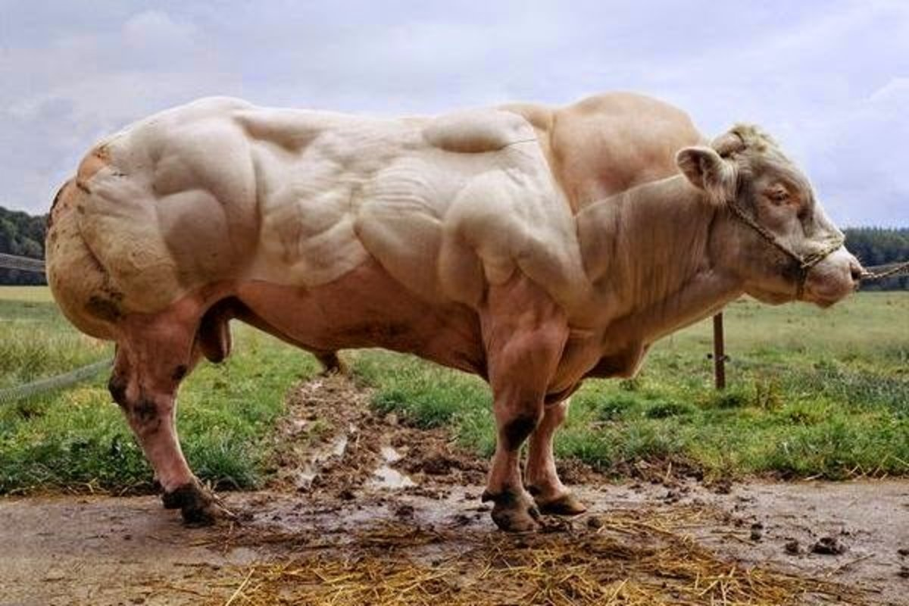
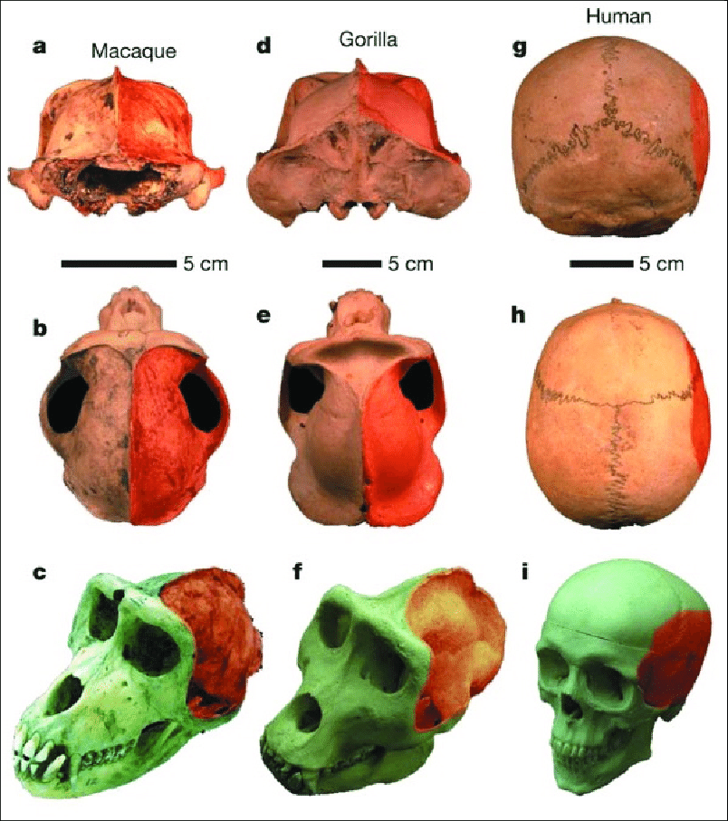
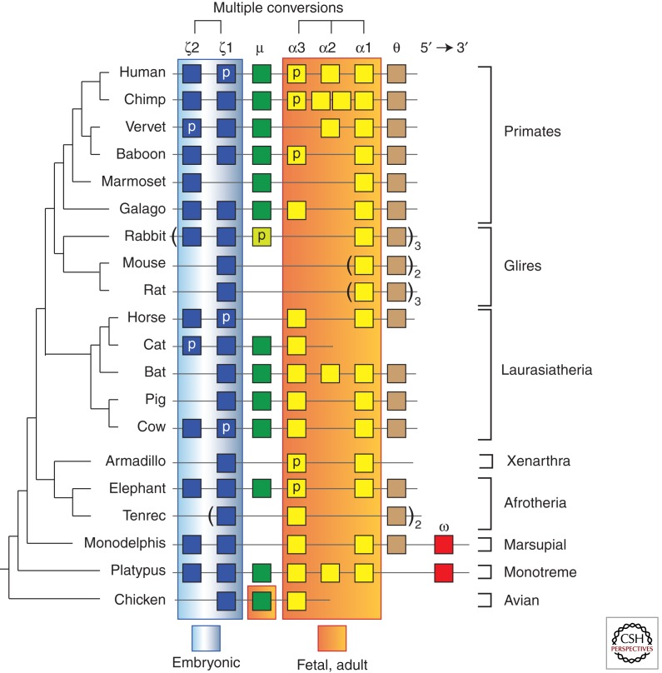
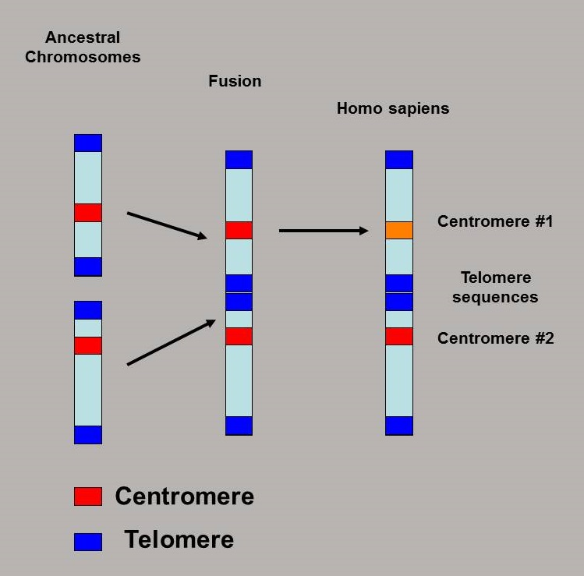

Slide 16
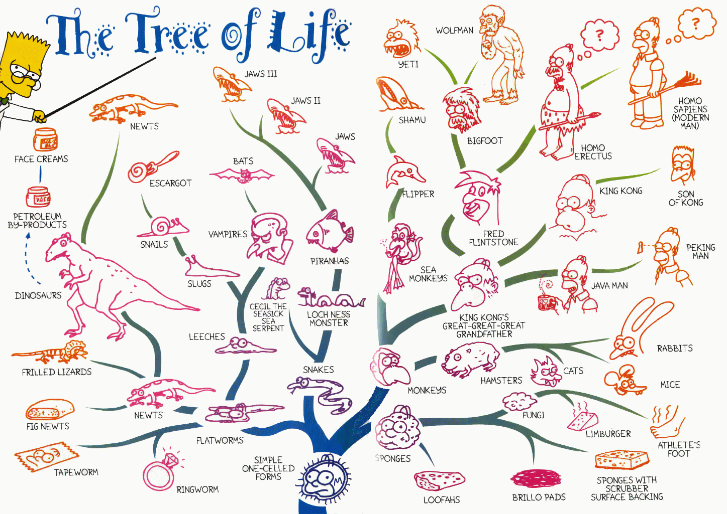
EVOLUTION : THE EVIDENCE AND ITS CONCEPTS
gi.cebitec.uni-bielefeld.de/ people/boecker/bi...
Episcopal Academy 2006

Slide 17
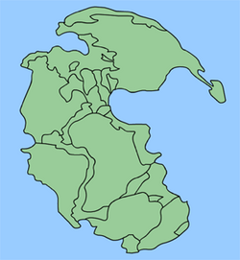
Biogeography
Pangaea (250-200 mya)
Geographic distribution
of species – plants and
animals are similar in
same geographic region
Pangea breaks apart 200mya
Continents as of today 20mya
Make predictions about where
fossils might be found.
Similar species occur nearby in
space because descended from
common ancestor

Slide 18
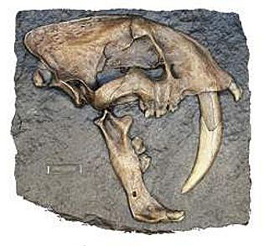
Paleontology
http://www.prometheus-imports.com/ms277saber-tooth-fossil.jpg
the study of extinct lifeforms and their fossils

Slide 19
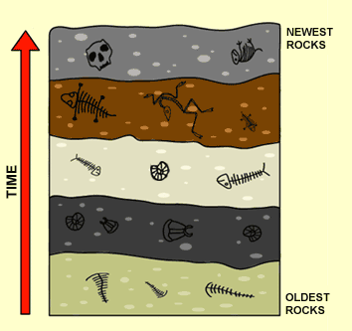
Geologic Succession And Fossils
- radioactive dating
- location of fossils
http://www.bbc.co.uk/schools/gcsebitesize/img/bifossils.gif

Slide 20
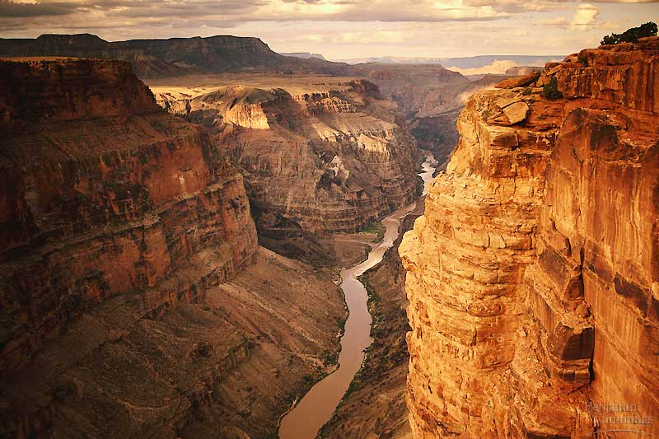
Figure 22.4 Strata of sedimentary rock at the Grand Canyon

Slide 21
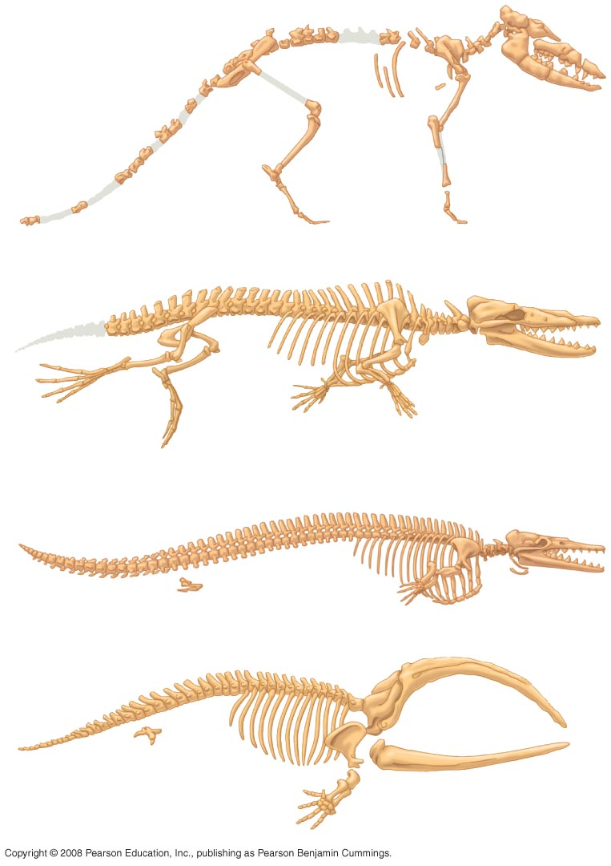
(a) Pakicetus (terrestrial)
(b) Rhodocetus (predominantly aquatic)
Pelvis and
hind limb
(c) Dorudon (fully aquatic)
Pelvis and
hind limb
Fin to Limb – 15’
(d) Balaena
(recent whale ancestor)

Slide 22
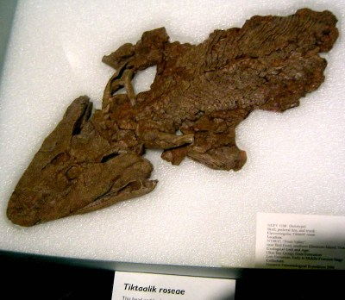
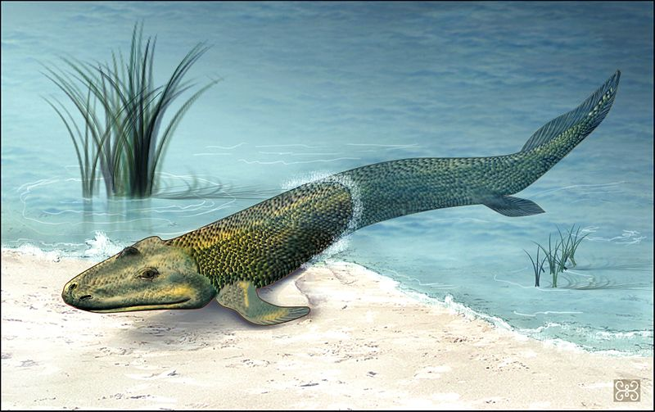
The identification of transitional fossils in particular is considered strong evidence for evolution
Tiktaalik:
lived approximately 375 mya (fossils discovered in 2004 in Canada)
is believed to be the intermediate form between certain fish (380 mya) fish and early tetrapods (365 mya)

Slide 23
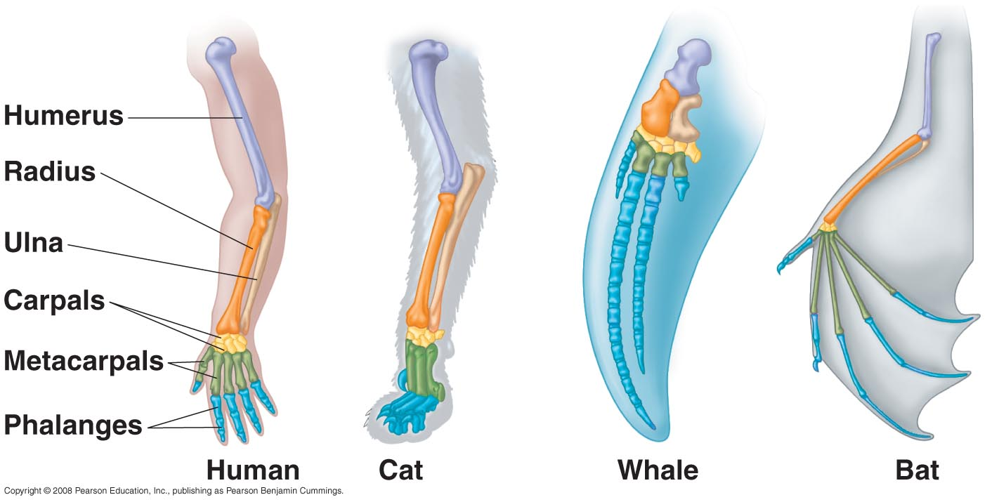
Homologous Structures
Same ingredients, different recipe

Slide 24
In thinking of homologous structures, consider:
Law of Used Parts
- same bones (STRUCTURE), different uses (FUNCTION)
Divergence of Structure and Function
- present structure/function derived from common ancestor

Slide 25
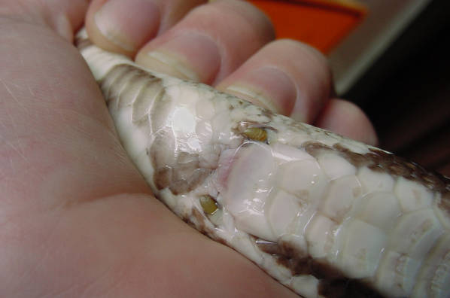
Vestigial Structures
Anatomy or Organs with No Apparent Function
Hind Leg Bones in Boas and Pythons
www.bio.miami.edu/ dana/160/homologous.jpg

Slide 26
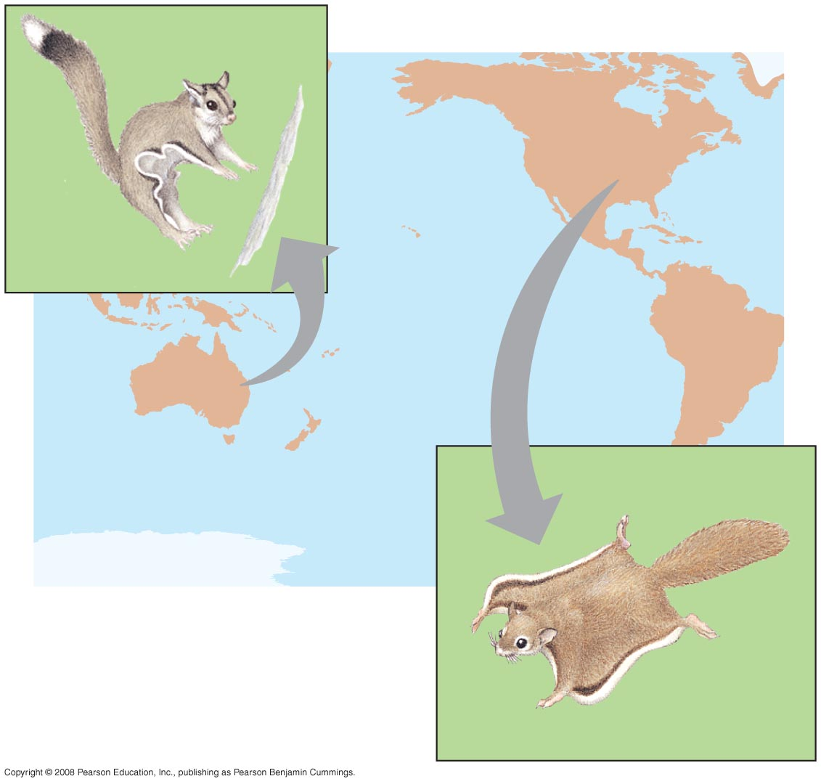
Not all organisms that appear similar are related by recent descent
NORTH
AMERICA
Sugar
glider
AUSTRALIA
Fig. 22-20
Flying
squirrel

Slide 27
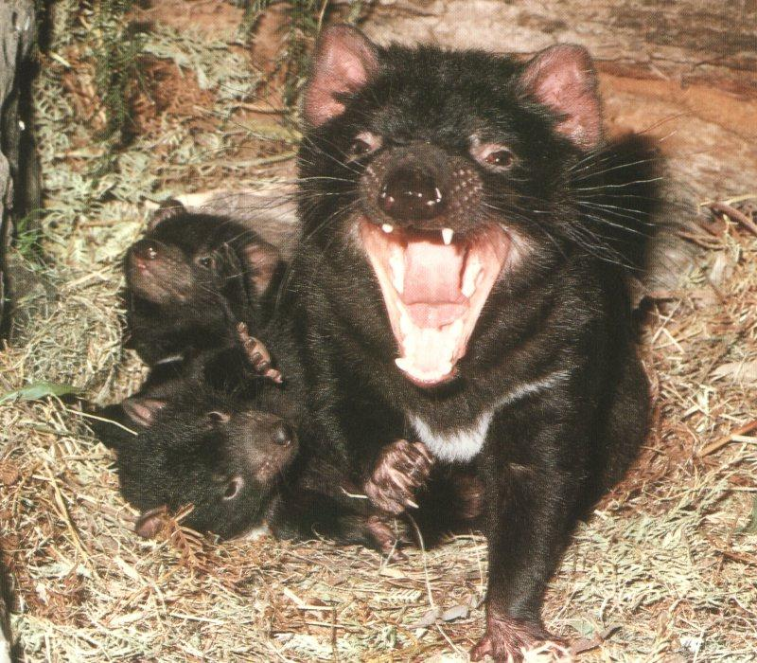
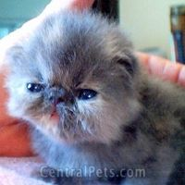
Convergent Evolution
Different geographic areas have populations or groups of plants and animals that exhibit similar appearance… even thought distantly related! WHY?
BEST EXAMPLE : MARSUPIALS AND PLACENTALS
http://biology.wsc.ma.edu/mammals/marsupials/TasmanianDevil01.jpg
http://www.centralpets.com

Slide 28
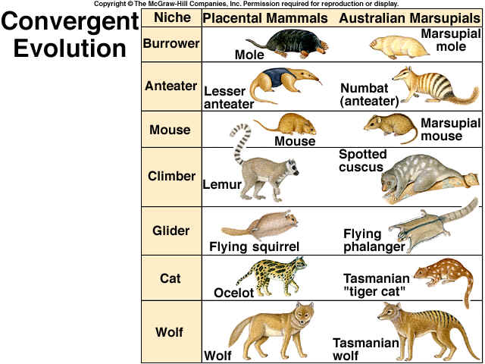

Slide 29
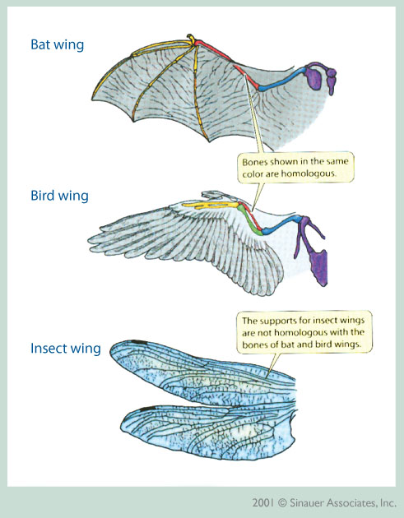
Analogous Structures
Similar features found in
different lineages.
Shows Convergence of Function

Slide 30
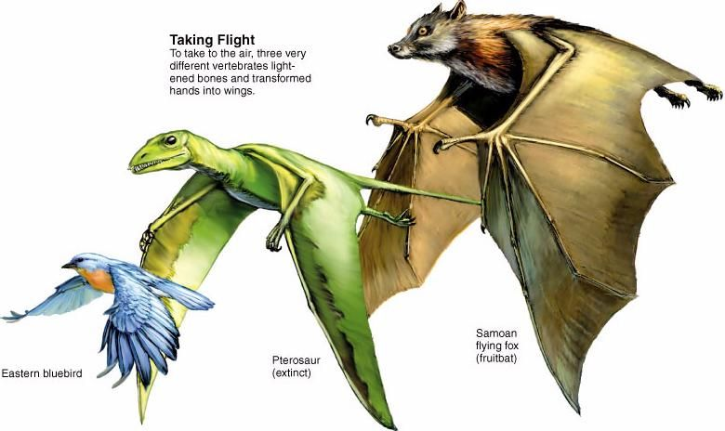

Slide 31
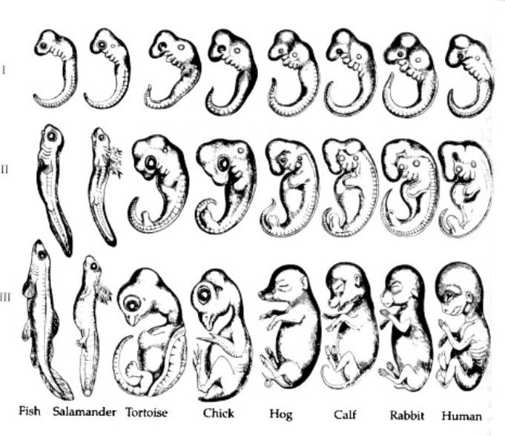
Embryology
http://earth.unh.edu/esci402/docs/embryology.jpg
The study of embryos and development

Slide 32
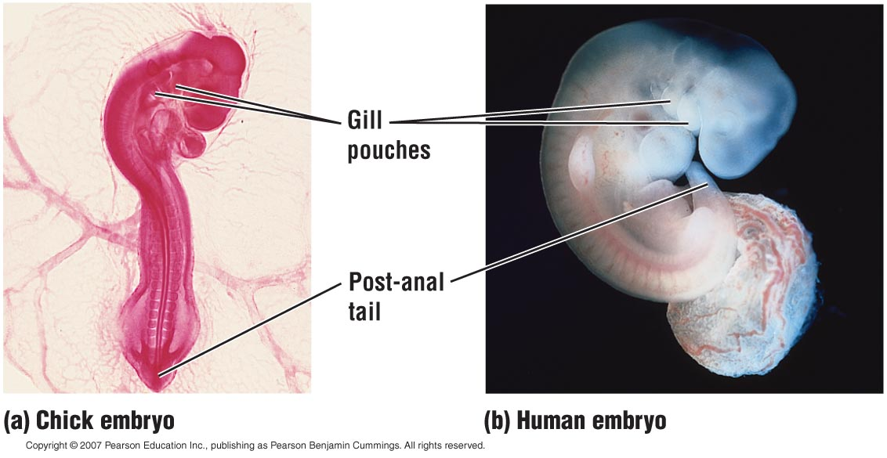
Figure 13.12

Slide 33
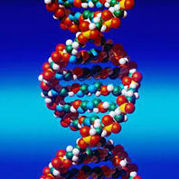
Molecular Record
Genes…DNA…and most importantly…??????

Slide 34
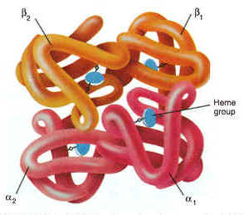
Hemoglobin
- can be compared to corresponding respiratory transport molecule in other species
- closely related organisms will exhibit fewer differences in the structure of this protein
http://health-pictures.com/images/Hemoglobin.jpg

Slide 35
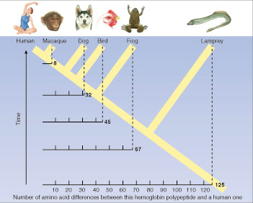
Using Molecular Data to Support Evolutionary Divergence
http://www.txtwriter.com/Backgrounders/graphics/evolution/page13.jpg

Slide 36
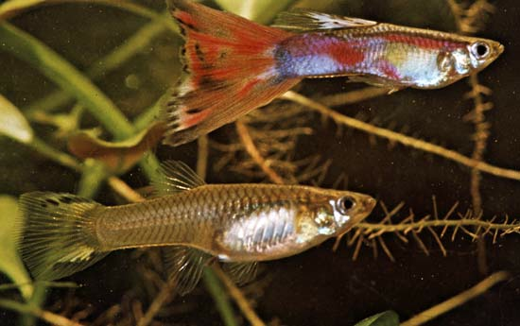
Evidence for evolution:
1. Direct observation of evolutionary change
Ex: Change in frequency of individuals with bright color patterns due to predation
Poecilia reticulata

Slide 37
Direct Observations of Evolutionary Change
© 2011 Pearson Education, Inc.

Slide 38
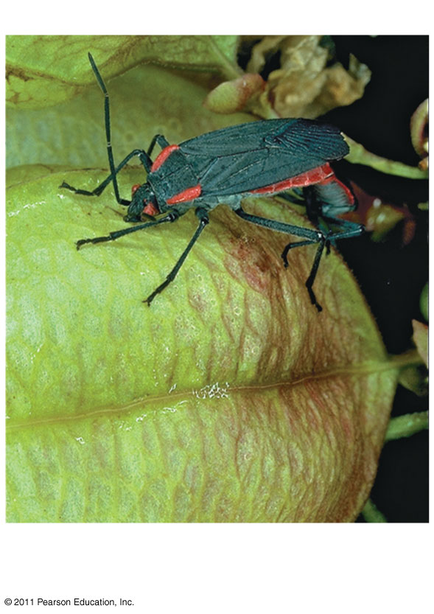
Figure 22.13a
FIELD STUDY
Can a change in a population’s food source result
in evolution by natural selection?
Native fruit is larger, more prevalent
in southern FL
Introduced species fruit is smaller, more
prevalent in central FL
Notes:
Figure 22.13 Inquiry: Can a change in a population’s food source result in evolution by natural selection?

Slide 39
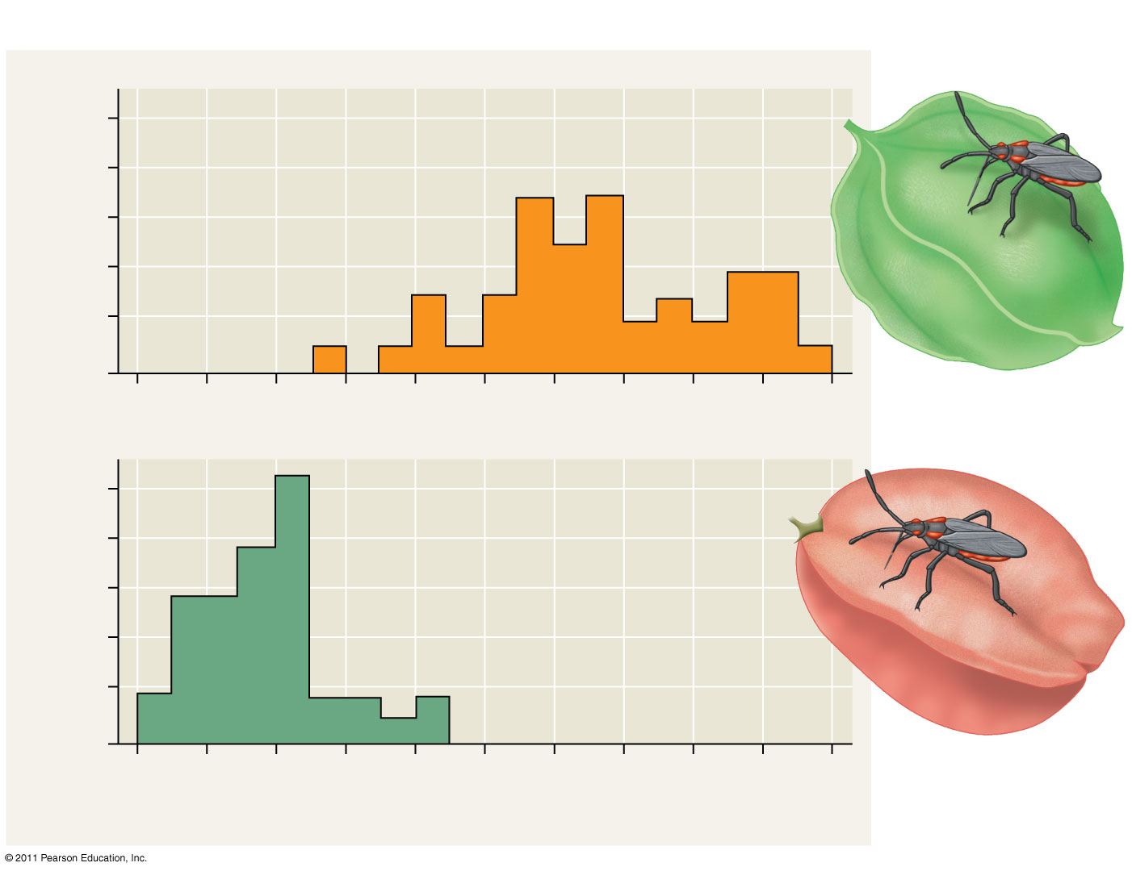
Figure 22.13b
RESULTS
Beak
10
On native species, southern Florida
8
6
4
2
0
Number of individuals
Museum-specimen average
10
8
On introduced species, central Florida
6
4
2
0
6
7
8
9
10
11
Beak length (mm)
Notes:
Figure 22.13 Inquiry: Can a change in a population’s food source result in evolution by natural selection?

Slide 40
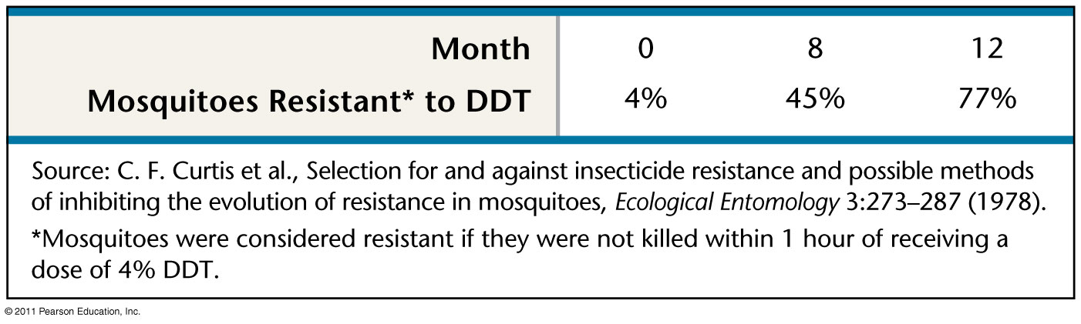
Figure 22.UN03
Evolutionary Arms Race
Notes:
Figure 22.UN03 Test Your Understanding, question 7

Slide 41
Gene Variation
Microevolution … “Adaptation by Natural Selection”
-evolutionary changes in gene frequency
-leads to microevolution within a species
Macroevolution …”Accumulation of These Changes”
-creation of new species
-extinction of old ones

Slide 42
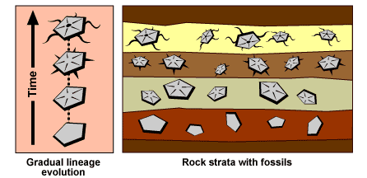
Pace of Evolution
Gradualism
http://evolution.berkeley.edu/evosite/evo101/VIIAPaceevolution.shtml

Slide 43
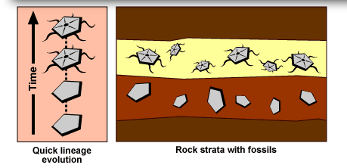
Pace of Evolution
Punctuated Equilibrium
http://evolution.berkeley.edu/evosite/evo101/VIIAPaceevolution.shtml

Slide 44


CAMBRIAN EXPLOSION AND BURGESS SHALE
Burgess Shale is best representation of Cambrian Life
Cambrian explosion represents “explosion of life” around 545 mya.
Burgess Shale found in Canadian Rockies
Life was restricted to oceans
Abundance of “weirdos,” trial and error…
Location of BS during Cambrian
Amphioxus

Slide 45

CEPHALOCHORDATES- 530mya
25 known species
Spend most of their time buried in sand
Filter-feed
Fossils are extremely sparse…why?
Examples:
Lanclets- scaleless, fish-like marine chordates
Amphioxus is around today!
5000 per square meter off Jamaican Coast
Pakaia, found in famous Burgess Shale

Slide 46


AGNATHANS- 500mya
lamprey
First animals with backbones (470mya)
Jawless fishes
Examples-
Hagfish, lamprey
Both parasitic fish
Have suckers and they attach themselves to other fish
HUGE Problem in Great Lakes…40 tons of fish killed!
hagfish

Slide 47


GNATHOSTOMES- 430 mya
CARTILAGINOUS FISHES
Have jaws…is this an advantage? why?
Jaws developed from gill arches
Skates, rays, sharks
BIG QUESTION: WHY ARE THEY SO SUCCESSFUL, STILL TODAY?

Slide 48

GNATHOSTOMES (cont.)
Bony Fishes
Internal skeleton of bones…what is this called?
Presents new problem?
Swim bladder-controls buoyancy in water

Slide 49

CROSSOPTERYGIANS- 400mya
Lobe-finned fishes
PATH TO LAND!!!
Paired front and hind limbs with internal bones
Muscular fins that could be used to crawl onto land
Thought to have died out, but fisherman recently caught one of the coast of Madagascar – Coelacanth!!!

Slide 50



AMPHIBIANS – 360 mya
Walking legs developed from lobe-fin fish
First on land = NEW PROBLEMS!!
Lungs!- squeeze air into lungs
Cutaneous respiration
Life cycles split between water and land, although reproduction still in water!
salamanders
frogs
newts

Slide 51


REPTILES- 300 mya
Amniotic egg- allows for reproduction on land…how? Cost/benefit!!!!
Scales on skin, so where do they get the extra air?
Expanded rib cage = bigger lungs!=more 0xygen
BIRDS
- “weird reptiles”
- scales are now what?
- hollow bones
- adaptations for what?

Slide 52



MAMMALS- 200 mya
Around with dinosaurs, but never very big…why?
Key adaptations: hair, mammary glands, endothermy- advantages???
Monotremes- egg-laying mammals- platypus (evolutionary left-over)
Marsupials- pouch mammals
Placentals –US!
K-T Extinction

